Slide 1
Antennas and Propagation Model

Slide 2
Introduction
An antenna is an electrical conductor or system of conductors
Transmission - radiates electromagnetic energy into space
Reception - collects electromagnetic energy from space
In two-way communication, the same antenna can be used for transmission and reception
Notes:
For transmission of a signal, radio-frequency electrical energy from the transmitter is converted into electromagnetic energy by the antenna and radiated into the surrounding environment (atmosphere, space, water).
For reception of a signal, electromagnetic energy impinging on the antenna is converted into radiofrequency electrical energy and fed into the receiver.

Slide 3
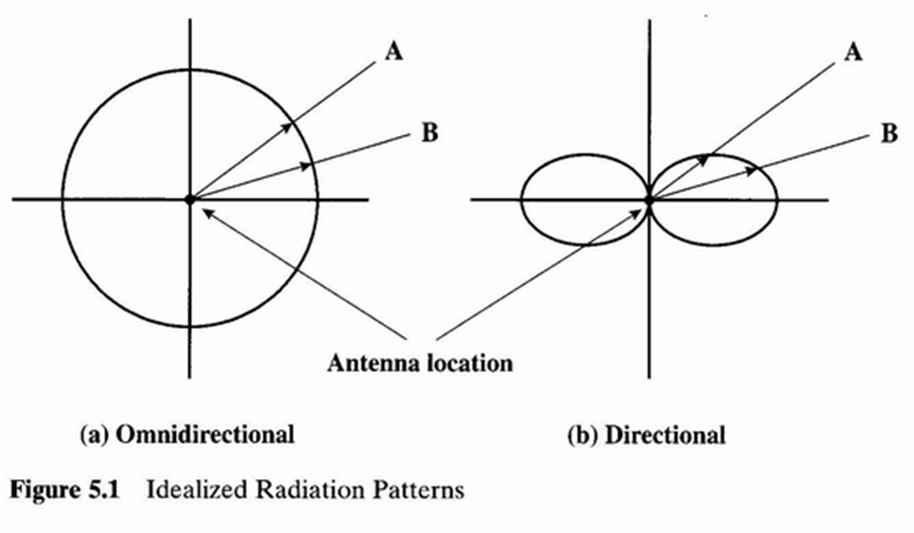
Radiation Pattern
A graphical representation of radiation properties of an antenna as a function of space.
Describes how the antenna radiates energy out into space (or how it receives energy).
Depicted as two-dimensional cross section
Notes:
An antenna will radiate power in all directions but, typically, does not perform equally well in all directions (better in some directions, and worse in others). A common way to characterize the performance of an antenna is the radiation pattern.
The distance from the antenna to each point on the radiation pattern is proportional to the power radiated from the antenna in that direction. Here power increase as the increase of distance.
Fig a. equal strength power is radiated in all direction. Fig b. more power is radiated in the B direction than A.

Slide 4
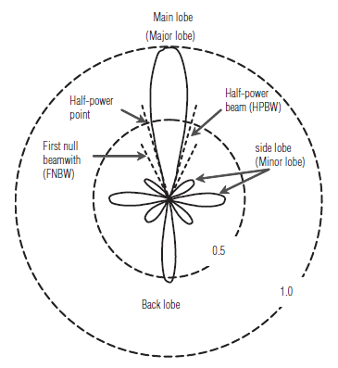
Radiation Pattern Parameter:
Main lobe: This is the radiation lobe containing the direction of maximum radiation.
Beamwidth: Also referred to as the half-power (3dB) beam width. It is the angle subtended by the half power points of the main lobe.
Minor lobe: All the lobes other than the main lobe are called the minor lobes. These lobes represent the radiation in undesired directions.
Back lobe: This is the minor lobe diametrically opposite to the main lobe.
Side lobes: These are the minor lobes adjacent to the main lobe and are separated by various nulls.
Notes:
Figure shows a radiation pattern. To measure its beam width, we need to identify its 3 dB point. Then measure the angle which is beam width 44 degree.
Subtended: form (an angle) at a particular point when straight lines from its extremities are joined at that point.
A null is a direction in an antenna's radiation pattern where the antenna radiates almost no radio waves.

Slide 5
Types of Antennas
• Isotropic antenna (idealized)
– Radiates power equally in all directions
• Dipole antennas
– Half-wave dipole antenna (or Hertz antenna)
– Quarter-wave vertical antenna (or Marconi antenna)
• Parabolic Reflective Antenna
• Directional Antennas
– Signal amplitudes and phases to each antenna are
adjusted to create a directional pattern
– Very useful in modern systems
Notes:
This types of antenna cannot be achieved in practice.

Slide 6
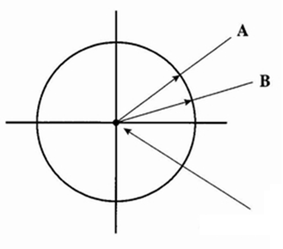
Types of Antennas
Isotropic antenna (idealized)
Radiates power equally in all directions.
The pattern of radiation is sphere with the antenna at the center.
The distance from the antenna to each point on the radiation pattern is proportional to the power from the antenna in that direction.
Notes:
This types of antenna cannot be achieved in practice.

Slide 7
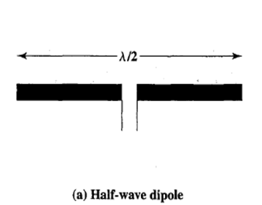
Dipole antennas
Half-wave dipole antenna (or Hertz antenna):
An antenna having a physical length of ½ the wavelength is called a hertz antenna or a half wave dipole antenna.
Consists of two straight collinear conductors of equal length separated by small gap.
The length of the antenna is one half of the wave length of the signal that can be transmitted most efficiently

Slide 8
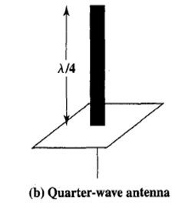
Dipole antennas
Quarter-wave vertical antenna (or Marconi antenna) :
An antenna having a physical length of 1/4 the wavelength is called a Marconi antenna or a Quarter-wave vertical antenna.
A vertical quarter wave antenna is the type commonly used for automobile radios and portable radios.

Slide 9
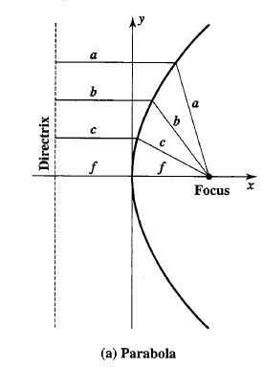
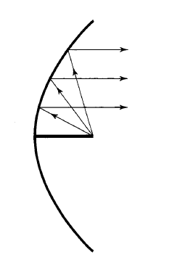
Parabolic Reflector Antenna
Used in terrestrial microwave and satellite applications.
A parabola is the locus of all points equidistant from a fixed line and a fixed point not on the line.
The fixed point is called the focus and the fixed line is called the directrix.
If a parabola is revolved about its axis, the surface generated is called a paraboloid.
If a source of electromagnetic energy is placed at the focus of the paraboloid, and if the paraboloid is a reflecting surface, then the wave will bounce back in lines parallel to the axis of the paraboloid.

Slide 10
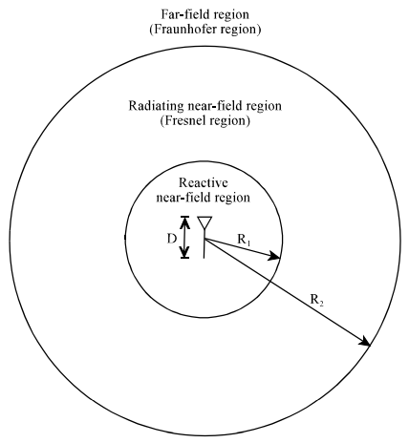
Antenna Field Types
The fields surrounding an antenna are divided into 3 principle regions:
Reactive Near Field
Radiating Near Field or Fresnel Region
Far Field or Fraunhofer Region

Slide 11

1. Reactive Near field
Reactive field can be characterized by standing (stationary) waves which represent stored energy.
Close to the antenna and up to about 1 wavelength away from any radiating surface.
The boundary of this region is commonly given as:
Notes:
Reactive field = imagine this region like a volume the antenna needs to "prepare" the field that will actually radiate.

Slide 12

2. Radiative Near-Field (Fresnel) Region
Radiative field can be characterized by radiating (propagating) waves which represent transmitted energy.
This is the region where the EM fields start to transition from reactive to radiating fields.
Since they have not completely transitioned, the shape of the radiation pattern still varies with distance.
The region is commonly given by:

Slide 13



3. Far-Field (Fraunhofer) Region
The far field is the region far from the antenna.
In this region, the radiation pattern does not change shape with distance.
Antennas are usually used to transfer signals at large distances which are considered to be in the far-field region.
One condition that must be met when making measurements in the far field region is that the distance from the antenna must be much greater than the size of the antenna and the wavelength.

Slide 14
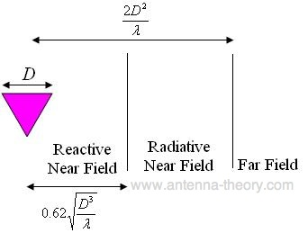
Antenna Field Regions

Slide 15
Example – 1.1
The audio power of the human voice is concentrated at about 300 Hz. a. What is the length of an antenna one-half wavelength long for sending radio at 300 Hz?
We have, =c/f i.e wavelength= speed of light/frequency of wave. Actual wavelength = (3*10⁸ m/sec) / 300Hz = 1000 Km
So the length of an antenna which is one-half of wavelength long is /2 =1000 Km/2 =500 Km
Antennas of the appropriate size for this frequency are impracticably large, so that to send voice by radio, the voice signal must be used to modulate a higher (carrier) frequency for which the natural antenna size is smaller.

Slide 16
Example – 1.1 cont..
b. An alternative is to use a modulation scheme, for transmitting the voice signal by modulating a carrier frequency, so that the bandwidth of the signal is a narrow band centered on the carrier frequency.
Suppose we would like a half-wave antenna to have a length of 1 m. What carrier frequency would we use?
Length of a half-wave antenna /2=1m i.e Wavelength = 2m
Therefore corresponding carrier frequency f = c/ = (3* 10⁸ m/sec) / (2 m) = 150 MHz.

Slide 17
Examples
Find the far-field distance for an antenna with maximum dimension of 1 m and operating frequency of 900 MHz.
An antenna has a diameter of 2m and frequency 16GHz. Calculate the 3 dB beamwidth for the antenna.
Notes:
Ans: Rappaport Example 3.1

Slide 18
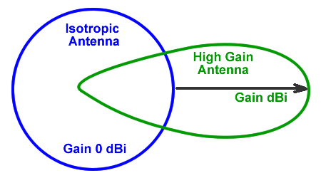
Antenna Gain
Power output, in a particular direction, compared to that produced in any direction by a perfect omnidirectional antenna (isotropic antenna)
G = (power radiated by an antenna)/(power radiated by reference antenna)
Example:
A transmitting antenna with a gain of 3 dB means that the power received far from the antenna will be 3 dB higher (twice as much) than what would be received from a lossless isotropic antenna with the same input power.

Slide 19
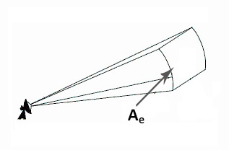
Effective Area of Antenna
Effective area (A_{e})
Related to physical size and shape of antenna
It is a theoretical value which is a measure of how effective an antenna is at receiving power.
The effective area can be calculated by knowing the gain of the receiving antenna.
Relationship between antenna gain and effective area
G = antenna gain
A_{e} = effective area
f = carrier frequency
c = speed of light ( 3 × 10⁸ m/s)
λ = carrier wavelength

Slide 20
Effective Area and G for Different Types of Antennas

Slide 21
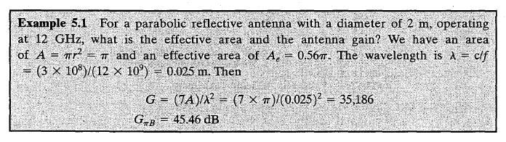
Example –2
For a parabolic reflective antenna with a diameter of 2 m, operating at 12 GHz, what is the effective area and gain?

Slide 22
Propagation Modes
Wave propagation is any of the ways in which waves travel.
Ground Wave (GW) Propagation: < 3MHz
Sky Wave (SW) Propagation: 3MHz to 30MHz
Effective Line-of-Sight (LOS) Propagation: > 30MHz

Slide 23
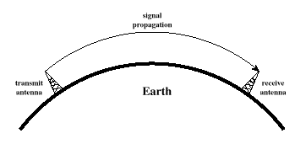
Ground Wave Propagation
Follows contour of the earth.
Can propagate considerable distances.
Frequency bands: ELF, VF, VLF, LF, MF.
Spectrum range: 30Hz ~ 3MHz, e.g. AM radio.
Notes:
Follows contour of the earth
Can Propagate considerable distances
Frequencies up to 2 MHz
Example
AM radio

Slide 24
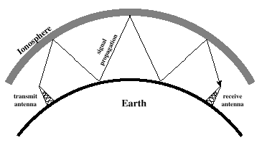
Sky Wave Propagation
Signal reflected from ionized layer of upper atmosphere back down to earth, which can travel a number of hops, back and forth between ionosphere and earth’s surface.
HF band with intermediate frequency range: 3MHz ~ 30MHz.
Example International broadcast.
Notes:
Signal reflected from ionized layer of atmosphere back down to earth
Signal can travel a number of hops, back and forth between ionosphere and earth’s surface
Reflection effect caused by refraction
Examples
Amateur radio
sw radio

Slide 25
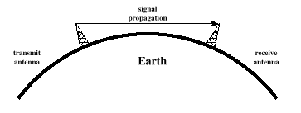
Line-of-Sight Propagation
Above 30 MHz, neither ground wave nor sky wave propagation modes operate, and communication must be by line of sight (LOS)
For satellite communication, signal above 30 MHz not reflected by ionosphere.
For ground communication, antennas within effective LOS due to refraction.
Frequency bands: VHF, UHF, SHF, EHF, Infrared, optical light
Spectrum range : 30MHz ~ 900THz.
Notes:
Transmitting and receiving antennas must be within line of sight
Satellite communication – signal above 30 MHz not reflected by ionosphere
Ground communication – The term effective is used because microwaves are bent or refracted by the atmosphere.

Slide 26
LOS calculations
d_{r}
d_{o}
optical horizon
radio horizon
earth
h
What is the relationship between h and d ?
For optical LOS:
where
h = antenna height (m)
d = distance between
antenna and horizon (km)
K = adjustment factor for
refraction, K = 4/3
For effective or radio LOS:
Notes:
Here the antenna is communicating with the ground level antenna.
Optical LOS is theoretical. Can not be measure for calculation.
Radio horizon = radio signal bents around the curvature of earth and hence travel longer distance than the line of sight signal.

Slide 27
LOS calculations (2)
d_{max}
Tx
Rx
h₁
earth
h₂
What is the Maximum distance between two antennas for LOS propagation ?
where h₁ = height of antenna 1
h₂ = height of antenna 2

Slide 28
Example (1)
d_{max}
Tx
Rx
h = 0m
h = 100m
earth
What is the maximum distance between two antennas for LOS transmission if one antenna is 100m and the other is at ground level?
Solution:

Slide 29
Example (2)
Tx
d_{max} = 41km
Rx
h₁
earth
h₂=10m
Now, suppose the receiving antenna is 10m high, what is the height of the transmitting antenna in order to achieve same distance above?
(Saving over 50m)

Slide 30
Problems
Find the optimum distance from the ground level for a half-wave dipole antenna of frequency 15 MHz.
Determine the height of an antenna for a TV station that must be able to reach customers up to 80 km away.

Slide 31
LOS Wireless Transmission Impairments
With any communications system, the signal that is received will differ from the signal that is transmitted, due to various transmission impairments:
Attenuation and attenuation distortion
Free space loss
Noise
Atmospheric absorption
Multipath
Refraction
Notes:
Strength of signal falls off with distance over transmission medium.
Attenuation happens in guided media.
Amplifier or repeater deal with first and second factor.
The third factor is known as attenuation distortion. Attenuation varies as a function of frequency. The frequency components of the received signal have different relative strengths than the frequency components of the transmitted signal. An equalizer can smooth up the signal.
To overcome this problem, techniques are available for equalizing attenuation across a band of frequencies. One
approach is to use amplifiers that amplify high frequencies more than lower frequencies.

Slide 32
Free Space Loss
For any type of wireless communication the signal disperses with distance.
If no other sources of attenuation or impairment are assumed, a transmitted signal attenuates over distance because the signal is being spread over a larger and larger area.This form of attenuation is known as free space loss.
The free space power received by an antenna which is separated from a radiating antenna by a distance is given by Friis free space equation.
Notes:
Signal disperses with distance.
An antenna with a fixed area will receive less signal power the farther it is from the transmitting antenna.

Slide 33
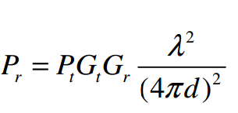
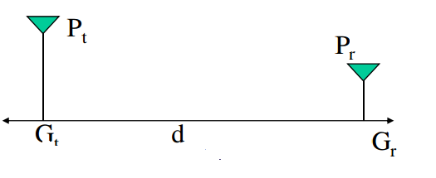
Friis Free Space Equation
The relation between the transmit and receive power is given by Friis free space equations:
G_{t} and G_{r} are the transmit and receive antenna gains
λ is the wavelength
d is the T-R separation
P_{t} is the transmitted power
P_{r} is the received power
P_{t} and P_{r} are in same units

Slide 34
Free Space Loss
Free space loss, ideal isotropic antenna
P_{t} = signal power at transmitting antenna
P_{r} = signal power at receiving antenna
λ = carrier wavelength
d = propagation distance between antennas
c = speed of light ( 3 × 10⁸ m/s)
where d and λ are in the same units (e.g., meters)
G_{t} = G_{r} =1

Slide 35
Free Space Loss
Free space loss equation can be recast:

Slide 36
Free Space Loss
Free space loss accounting for gain of other antennas
G_{t} = gain of transmitting antenna
G_{r} = gain of receiving antenna
A_{t} = effective area of transmitting antenna
A_{r} = effective area of receiving antenna

Slide 37
Free Space Loss
Free space loss accounting for gain of other antennas can be recast as

Slide 38
Examples
Assume that two antennas are half-wave dipoles and each has a directive gain of 3 dB. If the transmitted power is 1 W and the two antennas are separated by a distance of 10 km, what is the received power? Assume that the antennas are aligned so that the directive gain numbers are correct and that the frequency used is 100 MHz.
If a transmitter produces 50 watts of power, express the transmit power in units of (a) dBm, and (b) dBW. If 50 watts is applied to a unity gain antenna with a 900 MHz carrier frequency, find the received power in dBm at a free space distance of 100 m from the antenna, What is P (10 km) ? Assume unity gain for the receiver antenna.
Notes:
Rappaport Ex-3.2

Slide 39
Example-3
Determine the isotropic free space loss at 4 GHz for the shortest path to a synchronous satellite from earth (35,863 km). What is the power received at the satellite antenna? (Assume antenna gain of both the satellite- and ground-based antennas are 44 dB and 48 dB, respectively. a transmit power of 250 W at the earth station.)

